Slide 1


EE-SCHOOL
PROPOSED SOLUTION FOR SCHOOL OF DIGITALIZATION

Slide 2
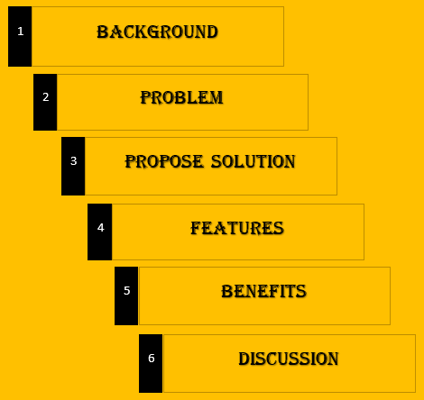

Slide 3
background
Normally the normal form of education is the physical meeting of teacher and student. But however the world in 2020 was hit with the COVID-19 pandemic Which brought the world in a state of hold, affecting many activities including studies making it difficult for physical studies to hold. This brought the usefulness of some platform like; Zoom, WhatsApp, Google meet which their rise increased to aid studying.

Slide 4
problem
In addition to the pandemic issues in Cameroon, the study also revealed that there were many challenges which PE teachers faced. PE teachers could not better do corrections for all his or her students and would not be able to attend to injuries in case any student sustained. Fitness and other engagements were people have to gather posted as a huge problem.
The first issue you may find is that some of your pupils aren't physically able to take part in lessons due to low fitness or ability levels. Some pupils may also be reluctant to take part in PE lessons due to concerns over their fitness levels, feelings of embarrassment or a lack of confidence.

Slide 5


Slide 6
Propose solution
A simplified Learning Platforms: Platform through Which student and teachers can henceforth teach and learn. with teachers able to schedule classes to be via video text, teachers being able to collect attendance share resources. Student having access to study resources and able to take quiz and exam ...in addition to many others

Slide 7
Fully accessible platform: the platform shall be easily accessible via mobile and web platform through the internet for lectures.
Real time statistics: Stake holders involved should be able to be interactive with each other, seeing any activity which been carried except otherwise restricted. Also, teachers been able to collect attendance and note participating students.
An area for students to leave a message and the teacher is immediately notified.

Slide 8
A teacher can do a screen record on zoom during explanation or would just edit his or her video at home and upload for the students to swallow concepts in bits and at given time frame. This will help distracted students or students with poor networks to get their lessons when network conditions are favorable for them.
Teachers be able to set quiz and exams and control. with an automatic grading system.

Slide 9

Features
A welcome page to the excellent electronic Learning
The home page for a desktop design

Slide 10

The home page for a mobile design

Slide 11

Home features on desktop display

Slide 12

The Footer for a desktop design

Slide 13
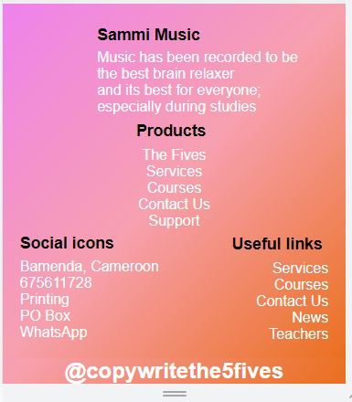
The Footer for an android display

Slide 14
The home page for a mobile design

Slide 15
The home page for a mobile design

Slide 16
The home page for a mobile design

